Slide 1
DevOps & Cloud Infrastructure SEIS 665 Week 11: Deployment Pipelines
Jason Baker
Adjunct Instructor
Graduate Programs in Software
University of St. Thomas
St. Paul, MN

Slide 2
Agenda
Deployment Pipelines
Jenkins
Pipeline-as-Code

Slide 3
Launching Jenkins
Use this Cloudformation template to launch a stack called jenkins in us-east-1:
https://s3.amazonaws.com/seis665/jenkins-cf.json
Provide a Jenkins username/password, and select your server key
Look at the stack outputs for the IP address of the Jenkins server.
Log into the Jenkins server with a web browser on port 8080:
http://ip_address:8080

Slide 4
Deployment Pipeline
A deployment pipeline is used to manage the deployment and testing of software using a set of validation stages whenever there is a code change.

Slide 5
Pipeline Benefits
Software is automatically built and tested.
Ready to go to production at any time.
Making changes to software is much easier.
Every change is tested the same way
Easier to automatically deploy changes versus using manual methods
Reinforces practice of using small batch sizes
Compliance and governance tasks are easier.
Traceability improved and tests are enforced.
Reduces need for heavy change control tasks.

Slide 6
Basic Pipeline Design
Local development stage
Developers run and test software on their local workstation
Natively, virtual machine (vagrant), container
Linting: a static code analysis process which identifies common syntax and style defects using a linter application.
Unit testing

Slide 7
Basic Pipeline Design
Build stage
Usually triggered when a developer checks new code into a VCS
Linting process
Code compilation (when necessary)
Unit tests
Possible local execution tests
Package code and store in an artifact repository

Slide 8
Basic Pipeline Design
Testing stage
Code artifact is deployed to a testing environment
Automated API and/or GUI tests are run against environment
Both integration and end-to-end testing
May leverage a grid-based testing solution
Non-functional testing (service resiliency)
Performance testing
Manual testing (pipeline is stopped and manually retriggered)

Slide 9
Basic Pipeline Design
Production deployment stage/ release
Code artifact is deployed to production environment
May be first applied to a staging environment for further testing before production
Automated smoke tests are run against deployment to validate application working properly

Slide 10
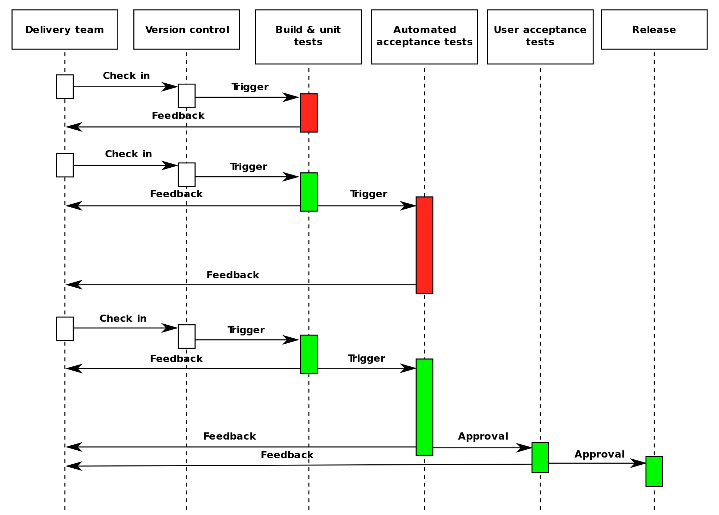

Slide 11
Deployment Pipeline Practices
Prove production-readiness for every change
All changes are potential releasable.
Only build your binaries once.
Don’t keep re-compiling or packaging app at each stage to minimize introduction of configuration inconsistencies.
Store application artifacts in a repository (example: Artifactory)
Deploy the same way to every environment.
Use the same script to deploy to a dev laptop, a test virtual machine, and a public cloud instance.
Store environment-specific configurations in separate files.
If any part of the pipeline fails, stop the line.
If a deployment to an environment fails, the whole team owns that failure and every effort should be taken to fix it.

Slide 12
Fan-in Pipelines
Multiple pipelines may feed a single assembly or deployment pipeline

Slide 13
Pipeline-as-Code
Traditionally we would create pipelines by defining jobs (stages) manually and linking them together.
Now it’s possible to define a pipeline using code.
Key benefit: The pipeline code can be stored in the same Git repository as the source code it is building and deploying.

Slide 14
Shared library pattern
Many project pipelines behave in similar ways.
Similar stages, testing processes, and deployment methods.
We can create reusable code modules to share methods across multiple pipelines.

Slide 15
Jenkins
An open-source automation server written in Java.
Started at Sun Microsystems in 2004 and known as the Hudson project.
Forked in 2011 after Oracle bought Sun Microsystems and renamed Jenkins.
Commercial version available from CloudBees.

Slide 16
Jenkins key terms
Jobs: define a specific set of tasks (workflow) which Jenkins will execute.
Workspace: a directory location on a Jenkins-managed system were a job will execute.
Executors: refers to the number of concurrent jobs that will run on a Jenkins system.
Environment variables: key/value pairs which a running job can use as input parameters.
Plugins: software modules which expand Jenkins functionality.

Slide 17
Jenkins interface
Review key parts of Jenkins interface:
Navigation menu
Top breadcrumb menu
Build history
Build Executor status

Slide 18
Jenkins plugins
Most of the functionality in Jenkins is provided by plugin modules
Manage Jenkins -> Manage Plugins
The plugins manager shows installed and available plugins.
Sometimes Jenkins must be restarted after a plugin is installed.
Two different implementations of Jenkins could look very different depending on the plugins installed!

Slide 19
Jobs
Let’s create a project.
Freestyle project called show-environment
Add a description and a single build step:
Execute shell
env | sort
Build the project
Look at the build output.
Review the Build History within the project and on the dashboard.
Note current build status and ”weather” report.

Slide 20
Jobs
Let’s update the show-environment project.
Add another command to the build step:
Execute shell
env | sort
false
Build the project
Notice that the build now fails (purposely) and look at the console output.
Review the Build History within the project and on the dashboard.
Note new build status and cloudy ”weather” report.

Slide 21
Jobs
Let’s fix the project by removing the false command.
Add a command to the build step to output the current build number:
Execute shell
env | sort
echo "Working with build ${BUILD_NUMBER}"
Build the project
Check out the build output.
The ${variable} syntax provides variable interpolation within Jenkins.

Slide 22
Github Integration
Configure Jenkins to access your Github repository.
Generate GitHub personal access token
Log into Github
Settings -> Personal access tokens
Generate new token
Description: Personal jenkins access
admin:repo_hook
repo
repo:status
Copy generated token and store in safe place
Manage Jenkins -> Configure System
GitHub Servers -> Add GitHub Server
Add Credentials
Kind: Secret Text
Copy Github token into Secret field
Description: Jenkins token
Test connection

Slide 23
Fork a Github project
Click the following link to fork a copy of a Java Github project into your personal account:
TBD

Slide 24
Java Project
Create a new freestyle project called: my-java-project
Configure the project settings and specify the GitHub project url
https://github.com/<github_username>/java-project/
Configure a Git repository under Source Code Management:
Repository URL
https://github.com/<github_username>/java-project.git
Save the configuration (no need to add any build steps) and build the project.
Look at the console output to see that Jenkins automatically pulled the repository.

Slide 25
Java Project
Let’s setup our project to automatically build our java code.
Modify the project configuration:
Execute shell command:
ant
Apache Ant is a build manager for Java projects.
Run the build and take a look at the console output.
Also, look at the workspace to see the build artifacts.

Slide 26
Java Project
We really don’t want to create build artifacts without testing our code first.
Go to the project configuration and add a build step that will run prior to our existing ant execution.
ant -buildfile test.xml
Run a new build and look at the console output to verify that the tests ran correctly.

Slide 27
Java Project
It would be nice to see the test results in a more visual format.
Go to the project configuration and add a post-build action:
Publish Junit test result report:
Test report XMLs: reports/*.xml
Run a new build and then look at the project main page.
Notice the Latest Test Result report.
Now, run another build and look at the project main page.
Jenkins will produce a trending test graph for your project.

Slide 28
Build Trigger
Most of the time we want to trigger builds based on an event -- like a new git commit.
Go to Github repository and setup Jenkins integration:
Repository -> Settings -> Integrations & services
Add Service
Jenkins (Github Plugin)
Jenkins hook url: http://<server IP>:8080/github-webhook/

Slide 29
Build Trigger
GitHub will send push notifications to our Jenkins server, but the project needs to be triggered.
Go to the project configuration:
Build Triggers
Check: GitHub hook trigger for GITScm polling
Go to the GitHub repo and make a small change to the README.md file and check it in.
Watch Jenkins automatically build the project!

Slide 30
Jenkins Pipeline DSL
Our previous Jenkins jobs were manually created.
We can use code to automatically define a Jenkins pipeline job.
Benefits:
Job configuration is kept in the same place as source code.
Pipeline configuration is stored in a source code repository.
We can share pipeline code between different projects using shared libraries.

Slide 31
Jenkins Pipeline DSL
Pipeline code is stored in a Jenkinsfile which is usually located in the root folder of a repo.
The Pipeline DSL is based on the Groovy language (which compiles and runs on JVM).
Two types of Jenkinsfile pipelines: declarative (simpler) and scripted (more advanced).
We’ll use declarative pipelines in this course.
I’ve only used scripted in practice.

Slide 32
Jenkinsfile example
pipeline {
agent any
stages {
stage(‘Build’) {
steps {
sh ‘ant’
}
}
stage(‘Test’) {
steps {
junit ‘reports/*.xml’
}
}
}
}

Slide 33
Jenkins Pipeline terms
Step: a single task which tells Jenkins to do something.
Node: tells Jenkins where to run the task.
Agent: indicates that Jenkins should allocate an executor and workspace for the pipeline.
Stage: a step which defines a distinct subset of the pipeline (build, test, deploy)
A stage will have one or more steps.

Slide 34
Homework
Assignment 10: Code Pipeline
Read Infrastructure as Code Chapters 9 & 14

